Slide 1

C# Fundamentals
Dara Oladapo
https://github.com/daraoladapo/csharp-lessons

Slide 2

WindForce Corp
The super company that does a lot of awesome things

Slide 3
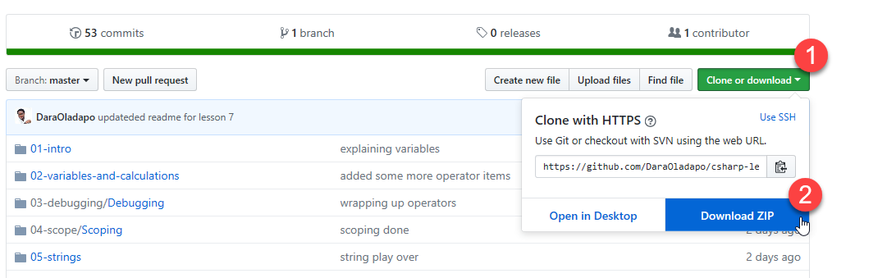

Slide 4

Lesson 1
Introducing C# and .NET
.NET
C#
Development Tools

Slide 5
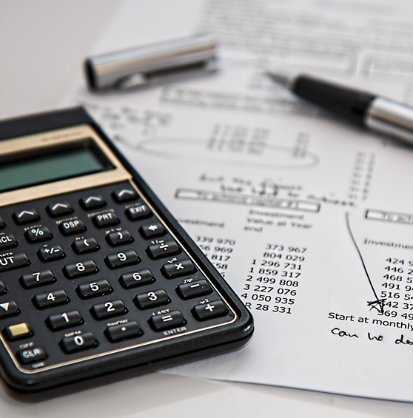
Lesson 2
Variables and Calculations

Slide 6
Data Types
Data Type | Meaning | Range
byte | Byte | 0 to 255
sbyte | Signed byte | –128 to 127
short | Small signed integer | –32,768 to 32,767
ushort | Unsigned short integer | 0 to 65,535
int | Integer | –2,147,483,648 to 2,147,483,647
uint | Unsigned integer | 0 to 4,294,967,295
long | Long integer | –9,223,372,036,854,775,808 to 9,223,372,036,854,775,807
ulong | Unsigned long integer | 0 to 18,446,744,073,709,551,615
float | Floating point | Roughly –3.4e38 to 3.4e38
double | Double-precision floating point | Roughly –1.8e308 to 1.8e308
decimal | Higher precision and smaller range than floating-point types
char | Character | single Unicode character.
string | Text | A string of Unicode characters.
bool | Boolean | Can be true or false.
object | An object | Can point to almost anything.

Slide 7
Data Type Suffix Characters
Data Type | Meaning
uint | U
long | L
ulong | UL or LU
float | F
double | D
decimal | M
string stringMessage="This is a string";
int intValue=52;
uint uintVal=52;
longValue=9223372036854775807;
double doubleValue=52.3;
float floatValue=33.2F;
decimalValue=25.56M;

Slide 8

Lesson 3
Debugging

Slide 9

Lesson 4
Scope

Slide 10

Lesson 5
Strings

Slide 11

Lesson 6
Dates and Times

Slide 12

Lesson 7
Arrays and Collections

Slide 13

Lesson 8
Enumerations and Structures

Slide 14

Lesson 9
Making Choices

Slide 15

Lesson 10
Repeating Program Steps

Slide 16

Lesson 11
Reusing Code with Methods

Slide 17

Lesson 12
Handling Errors

Slide 18

Lesson 13
Preventing Bugs

Slide 19

Lesson 14
Defining Classes

Slide 20

Lesson 15
Initializing Objects

Slide 21

Lesson 16
Fine-Tuning Classes

Slide 22

Lesson 17
Overloading Operators

Slide 23

Lesson 18
Using Interfaces

Slide 24

Lesson 19
Making Generic Classes

Slide 25

Lesson 20
Windows Apps with XAML

Slide 26

Lesson 21
System.IO

Slide 27

Lesson 22
Programming Databases

Slide 28

Lesson 23
LINQ to Objects

Slide 29
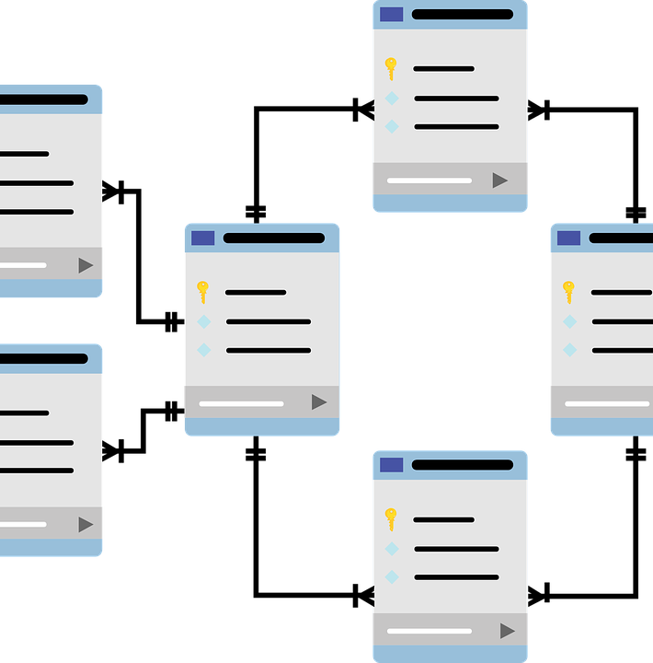
Lesson 24
LINQ to SQL

